Slide 1
Week 6: Image Enhancement in Transform Domain
Hazal Mogultay , Fatoş Tunay Yarman Vural

Slide 2
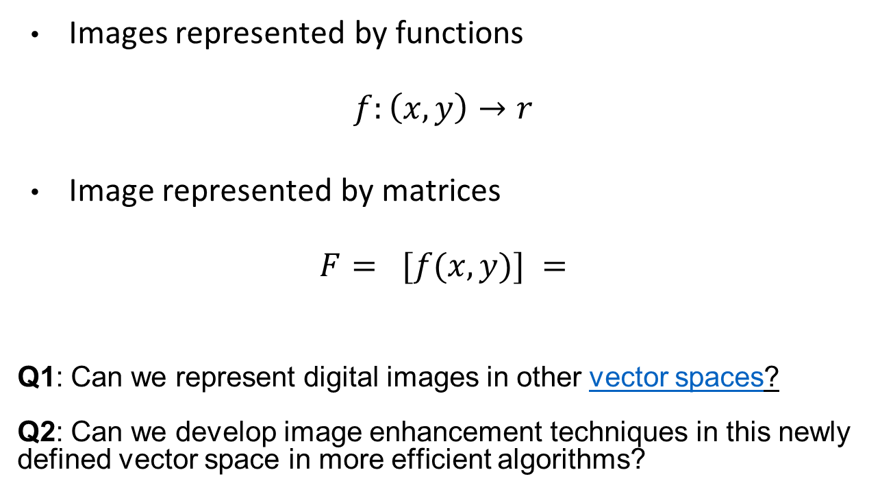
Recall, Space Domain Representation of Images
Images represented by functions
$$f:\left(x,y\right)→r$$
Image represented by matrices
$$F= [f(x,y)] =$$
Q1: Can we represent digital images in other vector spaces?
Q2: Can we develop image enhancement techniques in this newly defined vector space in more efficient algorithms?

Slide 3
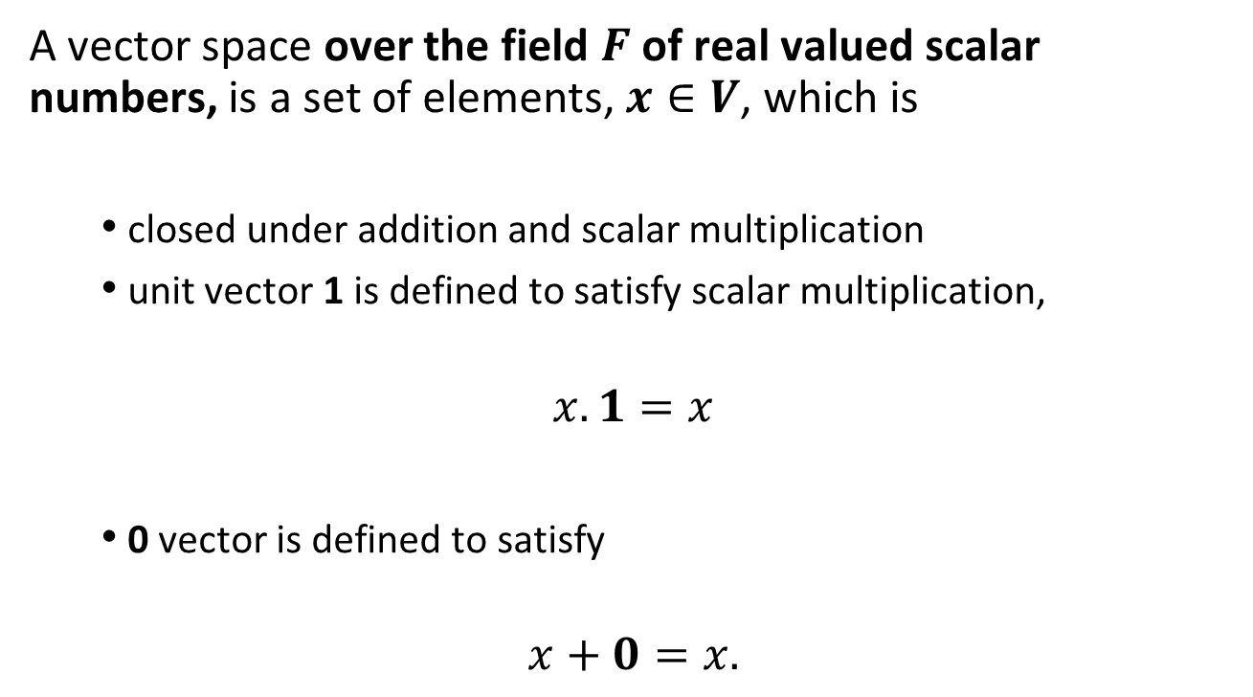
1. Vector spaces
A vector space over the field $F$ of real valued scalar numbers, is a set of elements, $x∈V$, which is
closed under addition and scalar multiplication
unit vector 1 is defined to satisfy scalar multiplication,
$$x.1=x$$
0 vector is defined to satisfy
$$x+0=x.$$

Slide 4
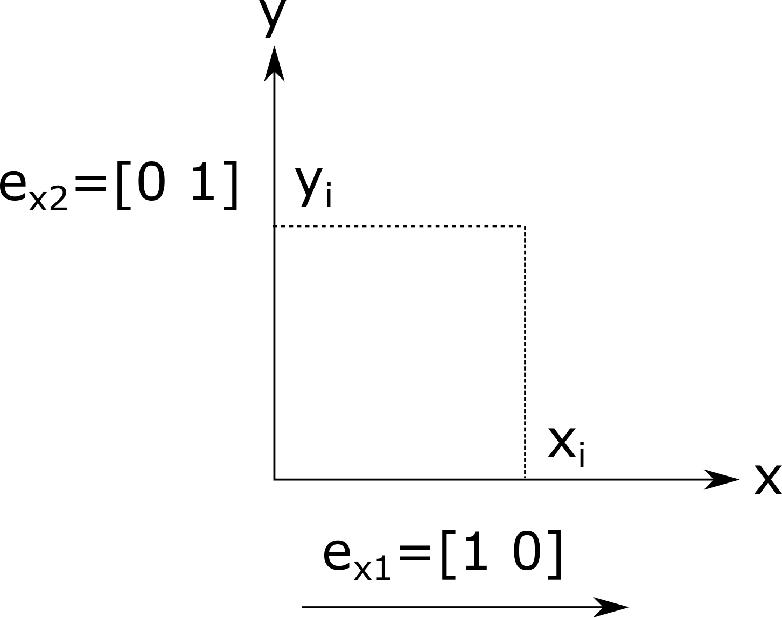





Example: 2-Dimensional Euclidean Space
$$x = [x1 x2]$$
$$x2$$
$$x1$$
Inner product: $<x,y>$ =: $x^{T}A$ y
Orthogonality:${ x}^{T}A$ y= 0 for x$≠y$
${{Standard Basis: e}_{1}=\left[1 0\right], e}_{2} =[0 1]$

Slide 5
Ex: Matrix Spaces: Show that the space of all NxM matrices, is a vector space. Suggest a set of basis for this vector space

Slide 6
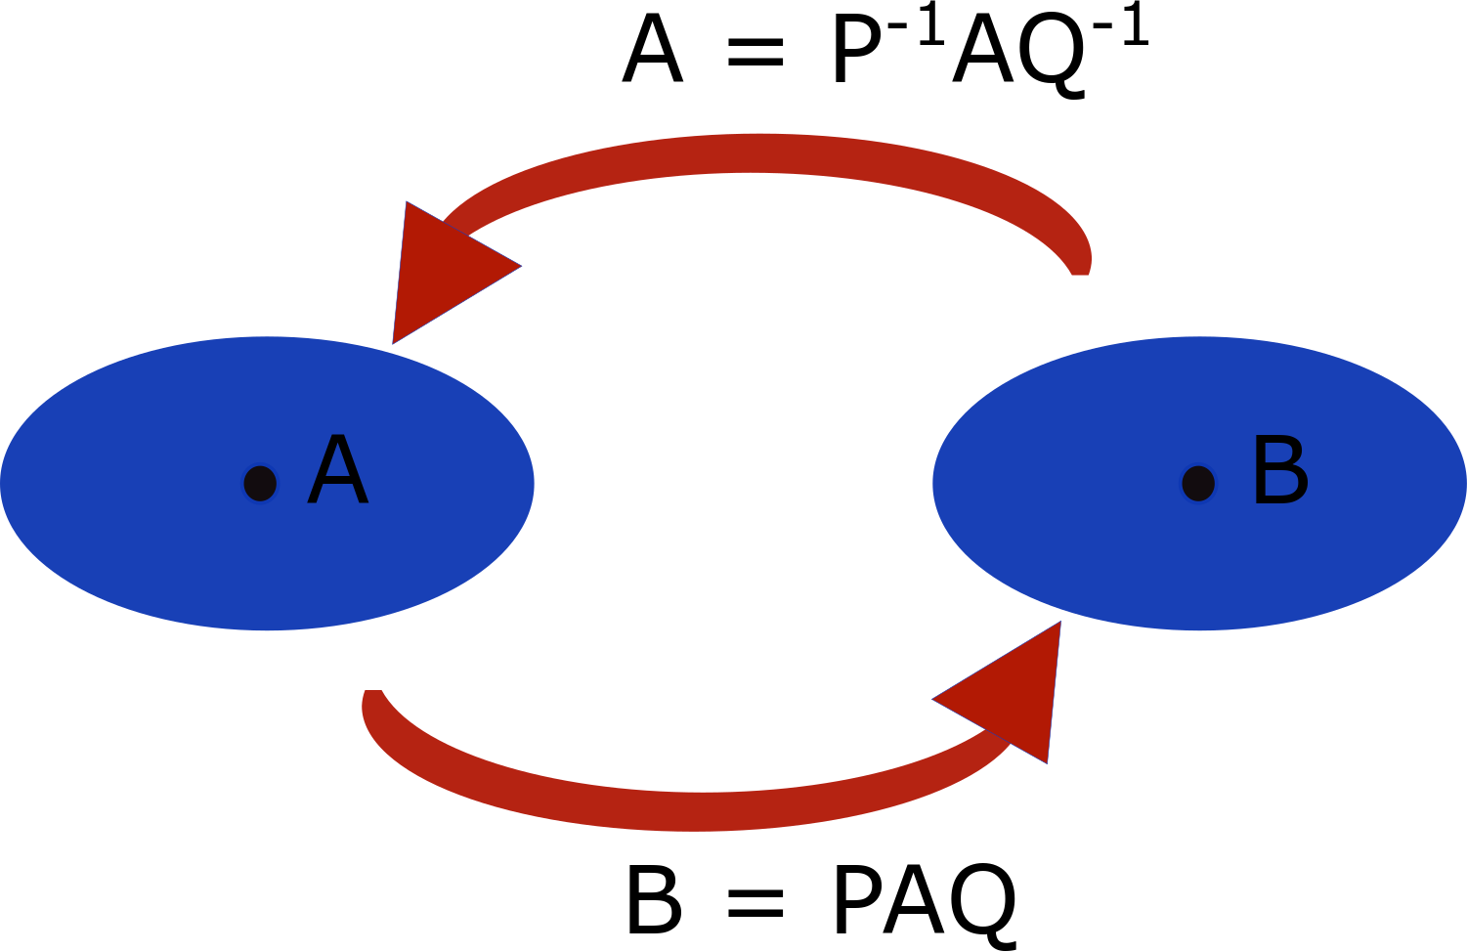
2. Matrix Similarity Transforms

Slide 7
Special Matrices
A real matrix A is called Orthogonal if its transpose is equal to its inverse,
A^{T}= A⁻¹.
A complex matrix,
A is called Hermitian if its conjugate transpose is equal to itself,
A^{∗T}=A.
A is called Unitary if its conjugate transpose is equal to its inverse,
A^{∗T}A =I .
A is called Hermitian and Unitary if it is equal to its inverse,
A⁻¹= A.

Slide 8

Ex: Show that the following matrix is orthogonal
$A= \begin{matrix}\cos{α} & sinα \\ sinα & −\cos{α}\end{matrix}$

Slide 9
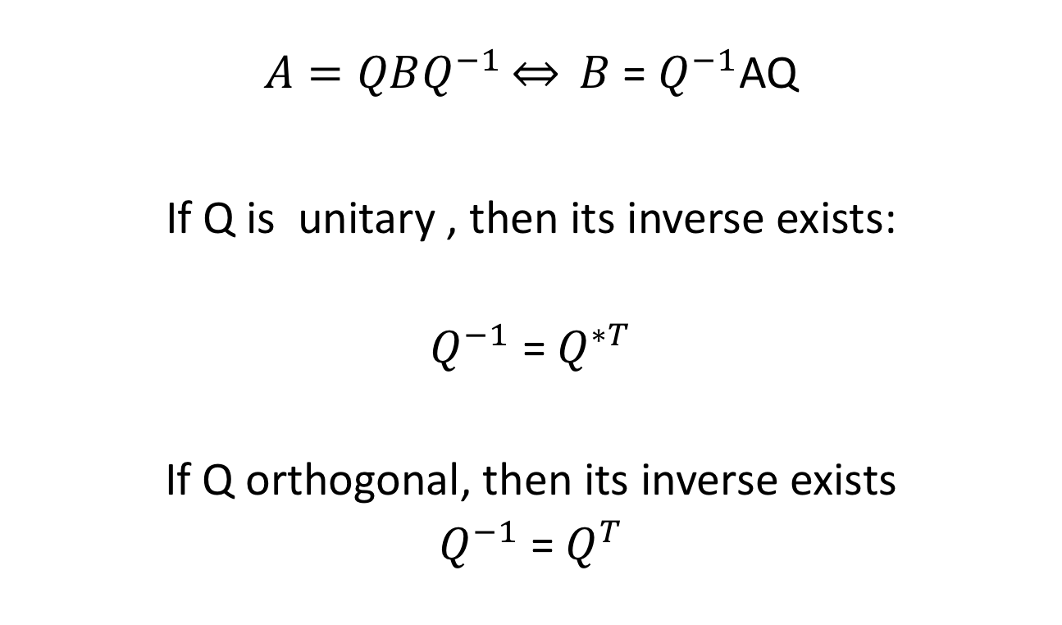
Matrix similarity transforms

Slide 10
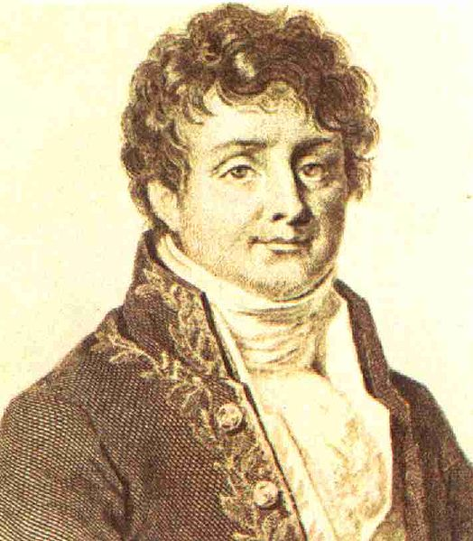
Fourier Transform J.B. Fourier 1768-1830

Slide 11

Fourier Transform of Continuous Functions: Almost all function can be represented as weighted exponentials of complex exponentials
$$F\left(u\right)≜ \int{f\left(x \right)} e 2πjux dx$$
$f\left(x\right)= ∫​ F\left(u\right){ e}^{2πjux}$ du
Note: F(u) is represented in a Hilbert space spanned by complex exponentials

Slide 12

Fourier Transform for 2-d Discrete Functions: Almost all 2-d functions can be represented as linear combination of complex exponentials
$$F(u,v)=∑ ∑ ​f(x,y) e^{−2πj(\frac{xu}{M}+\frac{yv}{N})}$$
$$f\left(x,y\right)=\frac{1}{MN} ∑ ∑ ​F(u,v)e^{2πj(\frac{xu}{M}+\frac{yv}{N})}$$

Slide 13
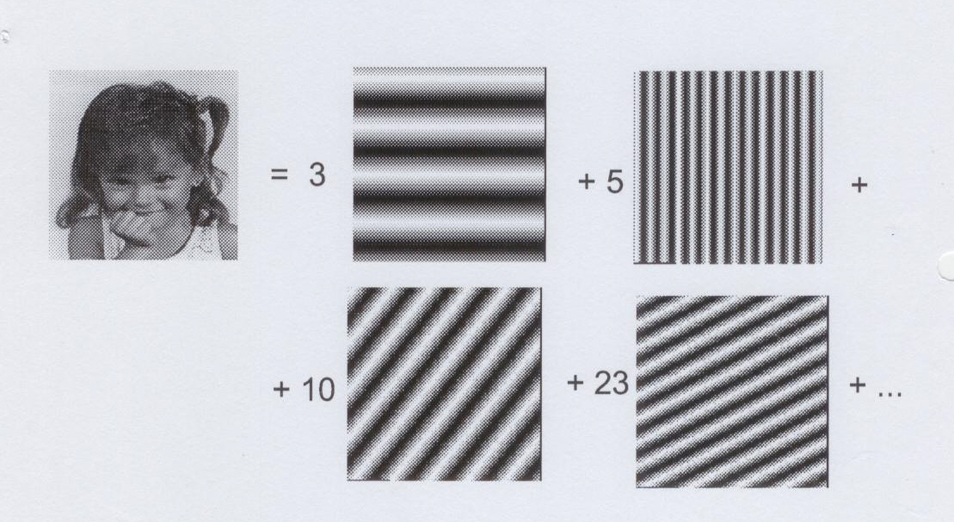
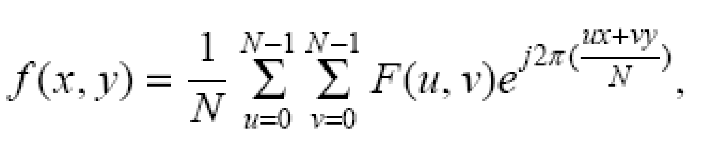

Basis functions of 2-D Fourier Domain

Slide 14

2-D Discrete Fourier transform as matrix similarity transform
$$F(u,v)=∑ ∑​f(x,y)e^{−2πj(\frac{xu}{M}+ \frac{yv}{N}})$$
$$f\left(x,y\right)=\frac{1}{MN}∑ ∑​F(u,v)e^{2πj(\frac{xu}{M} + \frac{yv}{N}})$$

Slide 15

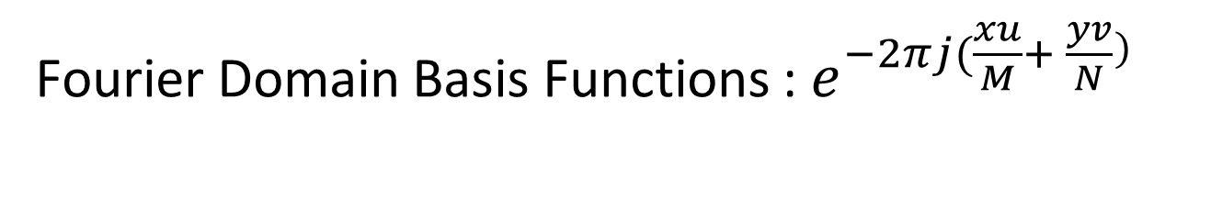
Fourier Domain Basis Functions : $e^{−2πj(\frac{xu}{M}+ \frac{yv}{N}})$
$$F(u,v)=∑ ∑​f(x,y)e^{−2πj(\frac{xu}{M}+ \frac{yv}{N}})$$

Slide 16
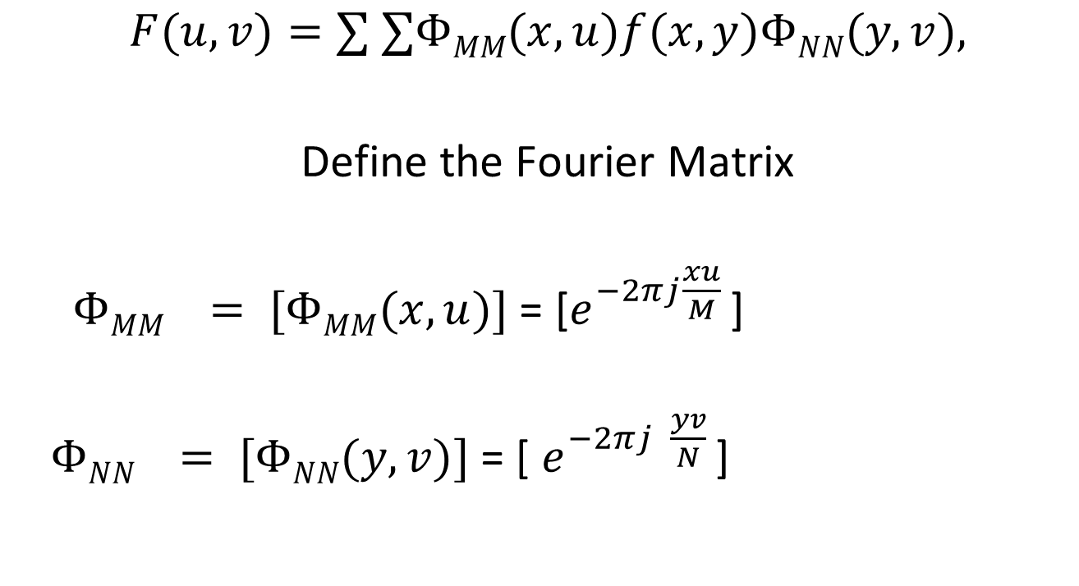
Split the complex exponential
$$F(u,v)=∑ ∑ΦMM​(x,u)f(x,y)ΦNN​(y,v),$$
Define the Fourier Matrix
$ΦMM​ = [ΦMM(x,u)]$= [$e^{−2πj\frac{xu}{M} }$]
$ΦNN​ = [ΦNN(y,v)]$= [ $e^{−2πj \frac{yv}{N} }$]

Slide 17
Define Image and Fourier matrix
Set the image matrix as
f = [f(x,y)] =
Set the Fourier matrix
F =[F(u,v)] =

Slide 18
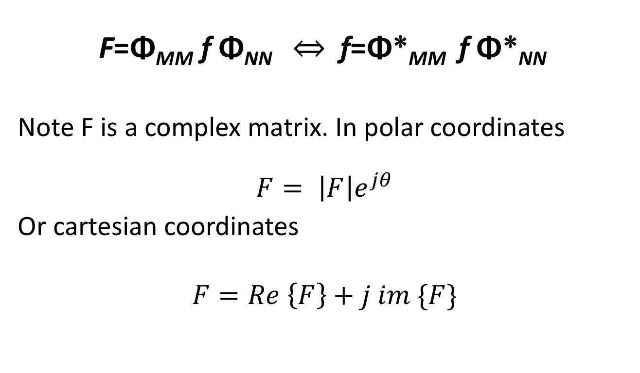
Fourier transform of an MxN image

Slide 19
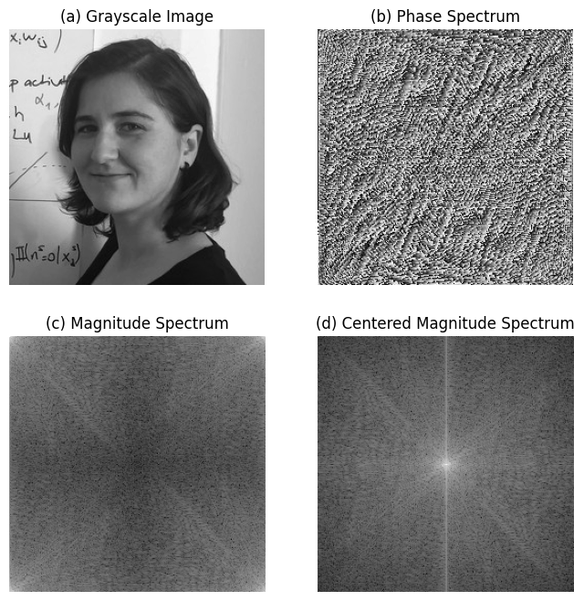

Slide 20
Note:
Phase spectrum is almost like a random noise. For this reason, in most of the applications, we ignore it while designing image processing algorithms, in the frequency domain.
Fourier Domain Compresses image. Most of the colors in the magnitude spectrum are black, showing that the corresponding frequency pair, (u,v), is zero.

Slide 21
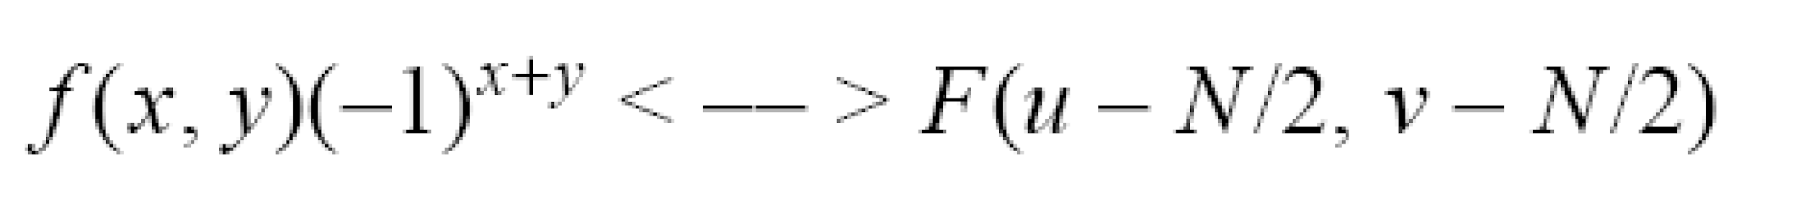
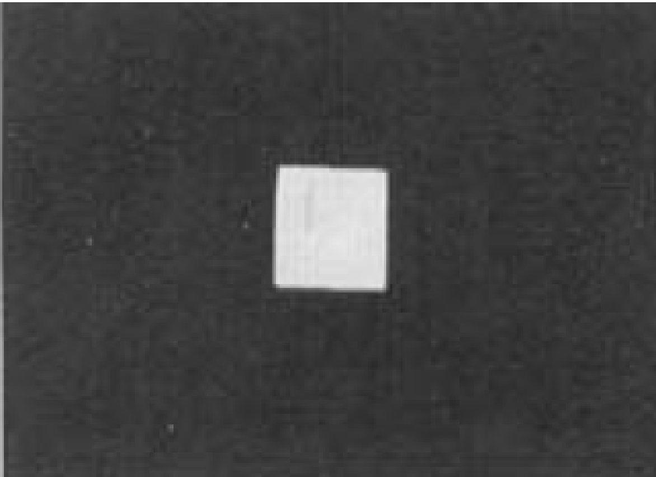

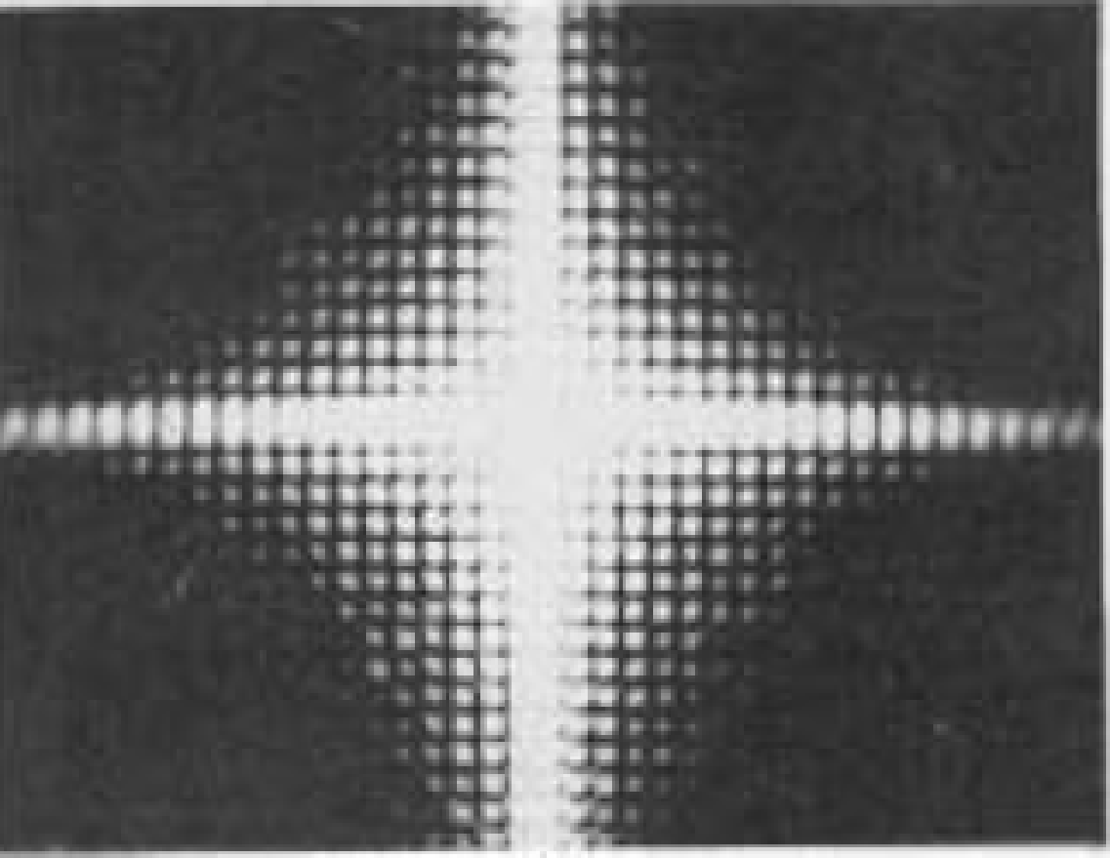
Centering the Fourier Transform
sinc
sinc
no translation
after translation

Slide 22

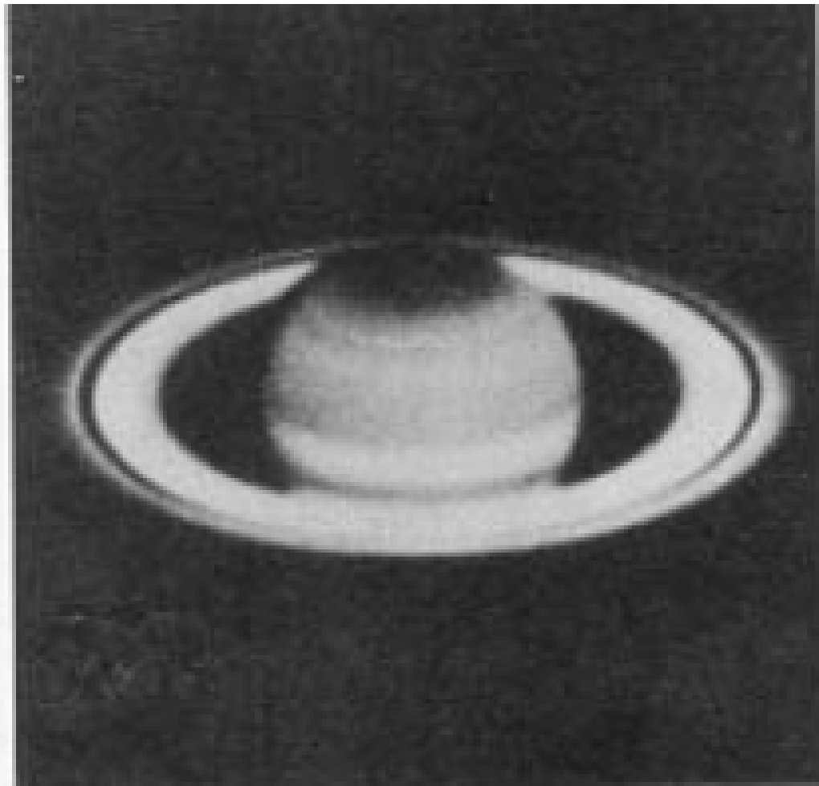
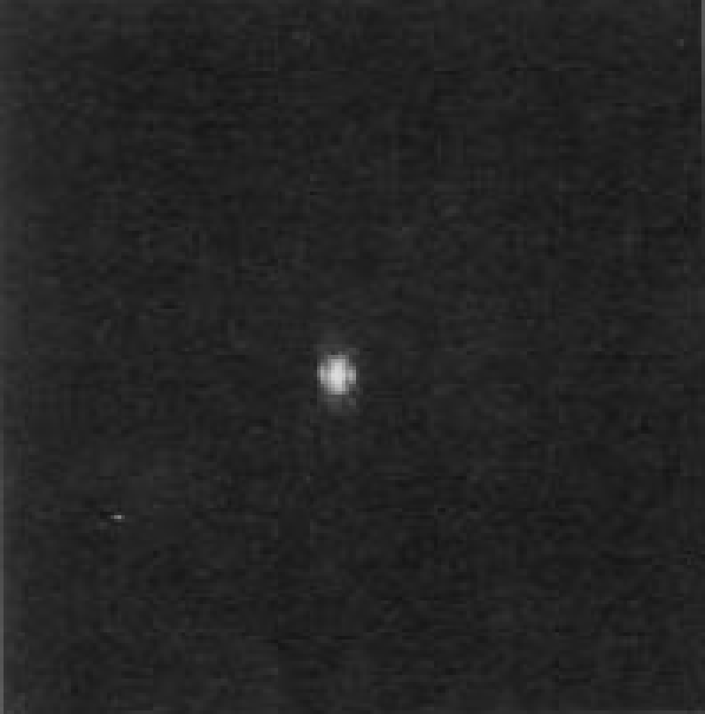
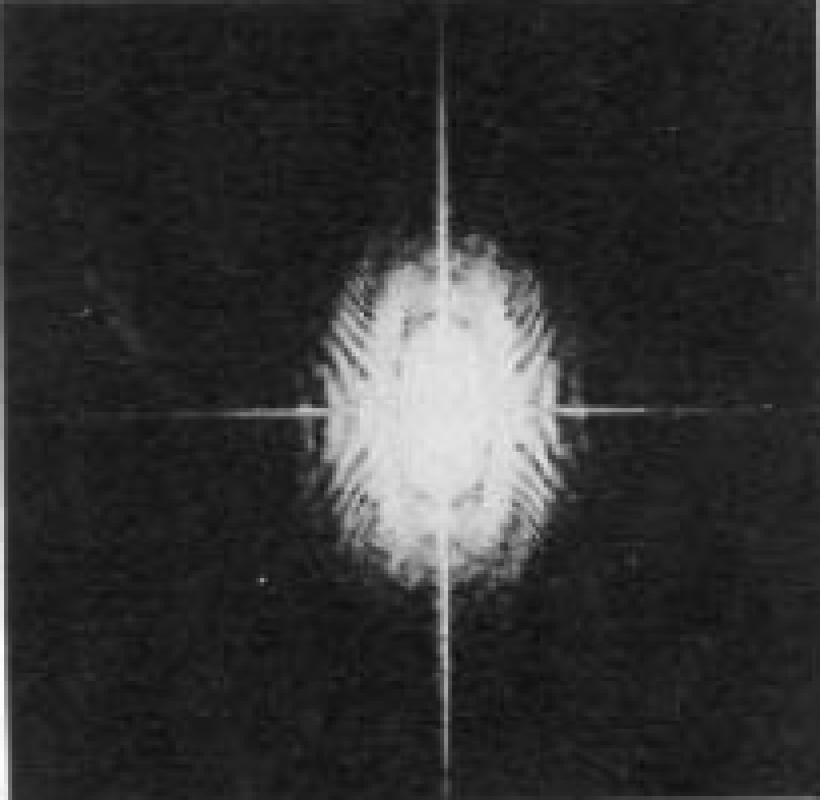
Stretching Fourier Transform
Typically, we visualize |F(u,v)|
The dynamic range of |F(u,v)| is typically very large
Apply streching: (c is const)
|F(u,v)|
|D(u,v)|
original image
before stretching
after stretching

Slide 23
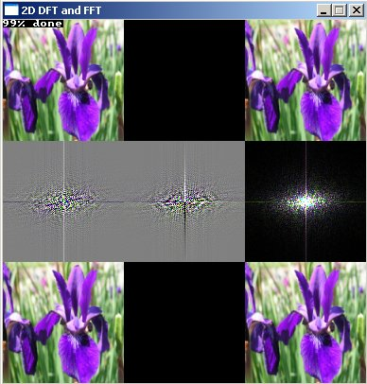
Original: Real, imaginary, amplidute
F.T.; Real, imaginary, amplitude
Reconstructed

Slide 24
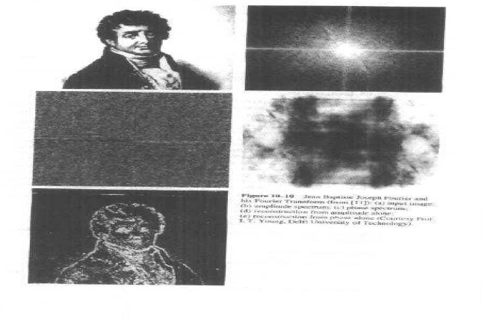
Fourier transform of Fourier: Centered Magnitude

Slide 25
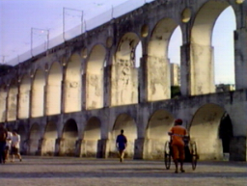
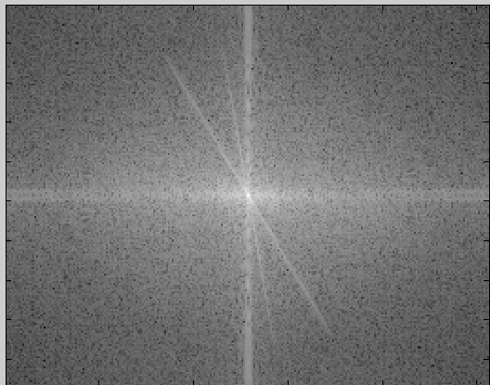
Image Processing in the Fourier Domain
Magnitude of the FT
Does not look anything like what we have seen

Slide 26
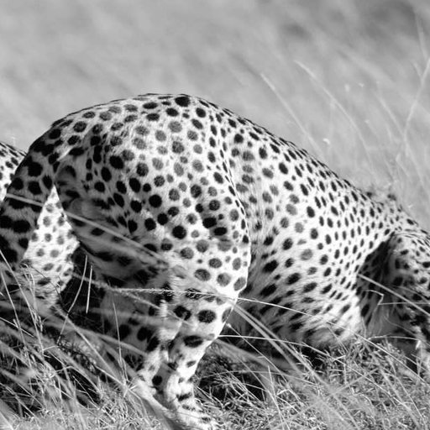
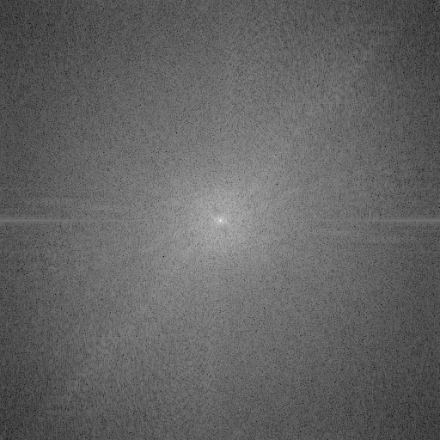
Image Processing in the Fourier Domain
Magnitude of the FT
Does not look anything like what we have seen

Slide 27
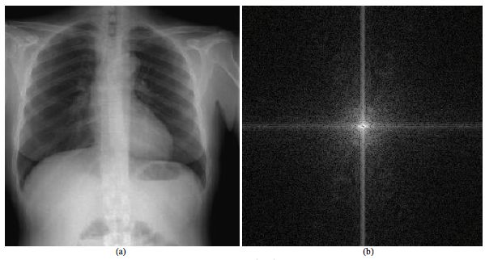

Slide 28
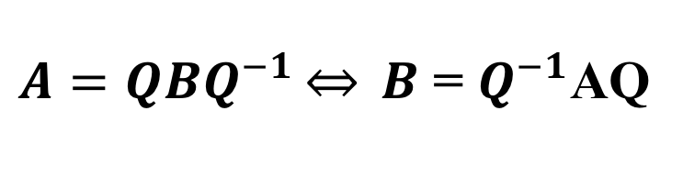
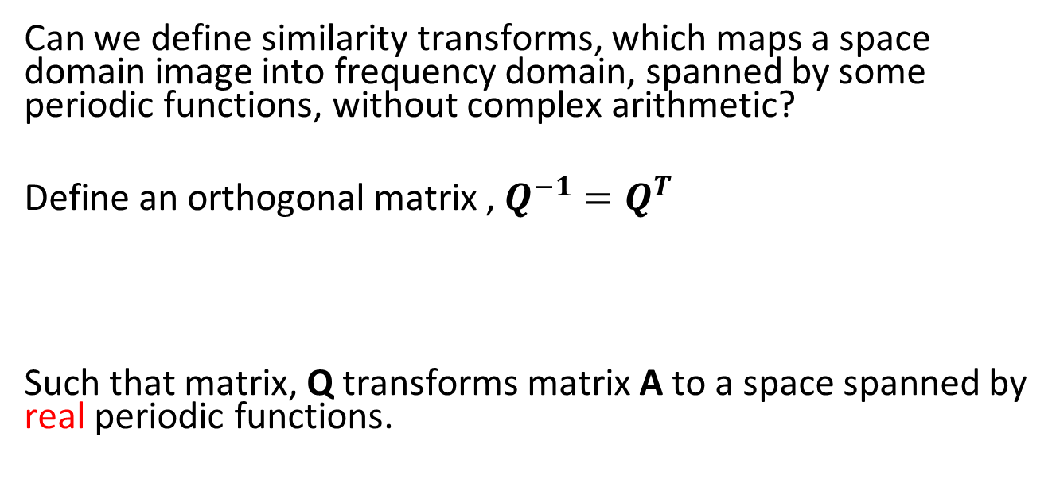
Discrete Cosine Transform
Can we define similarity transforms, which maps a space domain image into frequency domain, spanned by some periodic functions, without complex arithmetic?
Define an orthogonal matrix , $Q^{−1}=Q^{T}$
Such that matrix, Q transforms matrix A to a space spanned by real periodic functions.

Slide 29
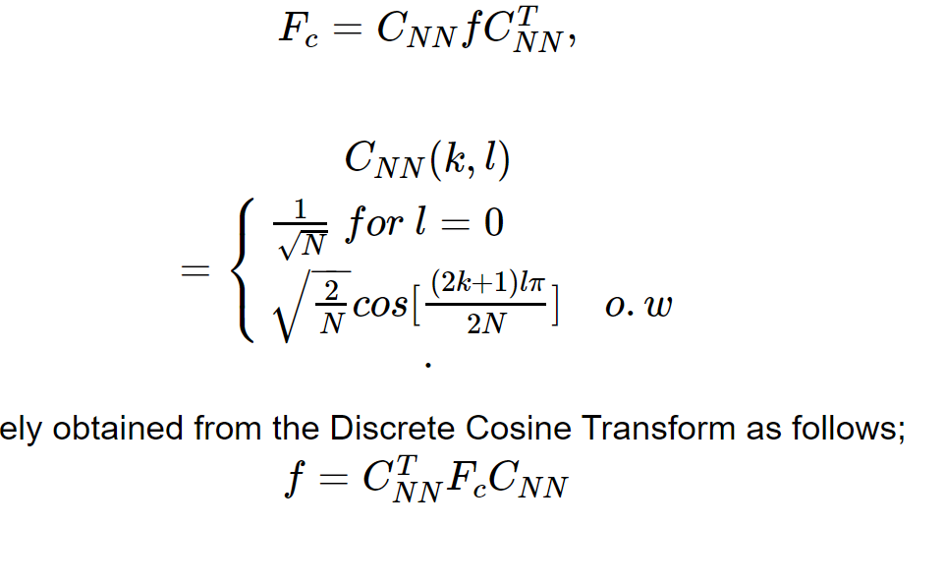
Discrete Cosine Transform, Nasır Ahmed, 1972
The inverse of the DCT is

Slide 30
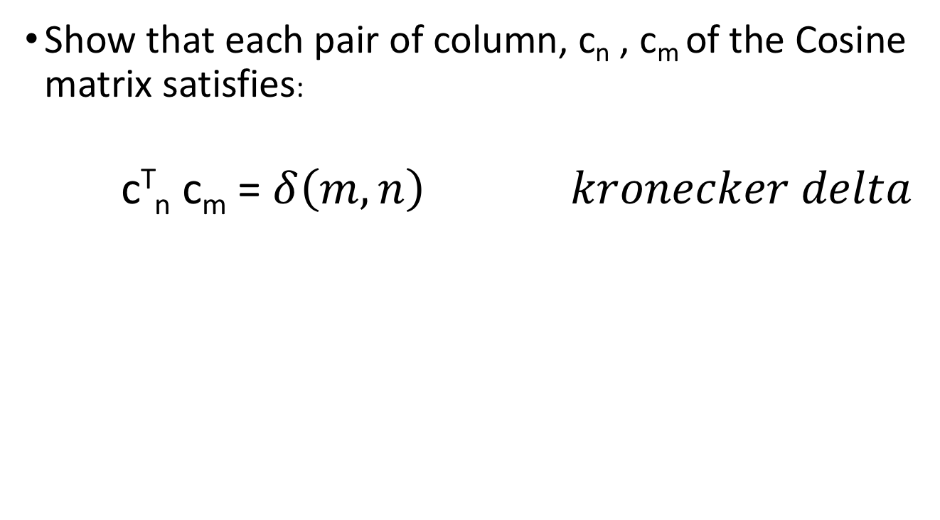
Show that Cosine basis functions are orthogonal

Slide 31
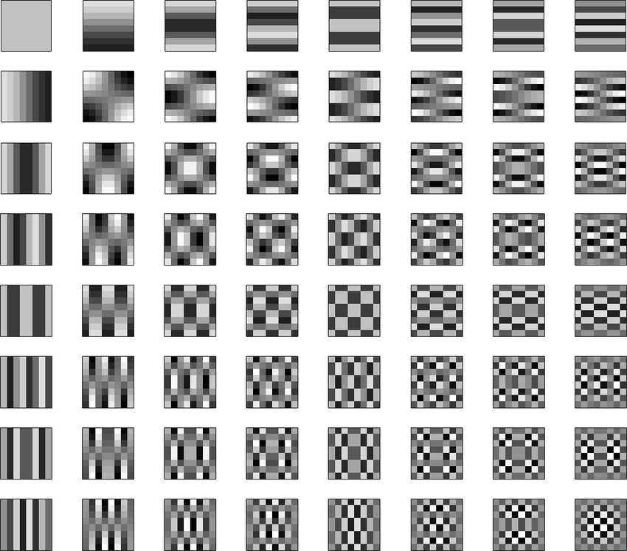
Two dimensional discrete cosine basis for 8x8 images

Slide 32
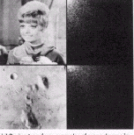
Discrete Cosine Transform

Slide 33
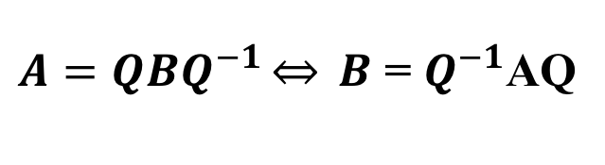
Hadamard Transform Jacques Hadamard, 1893
Can we design transform space which is spanned by the integer valued basis matrices?

Slide 34

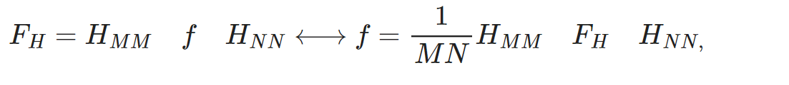
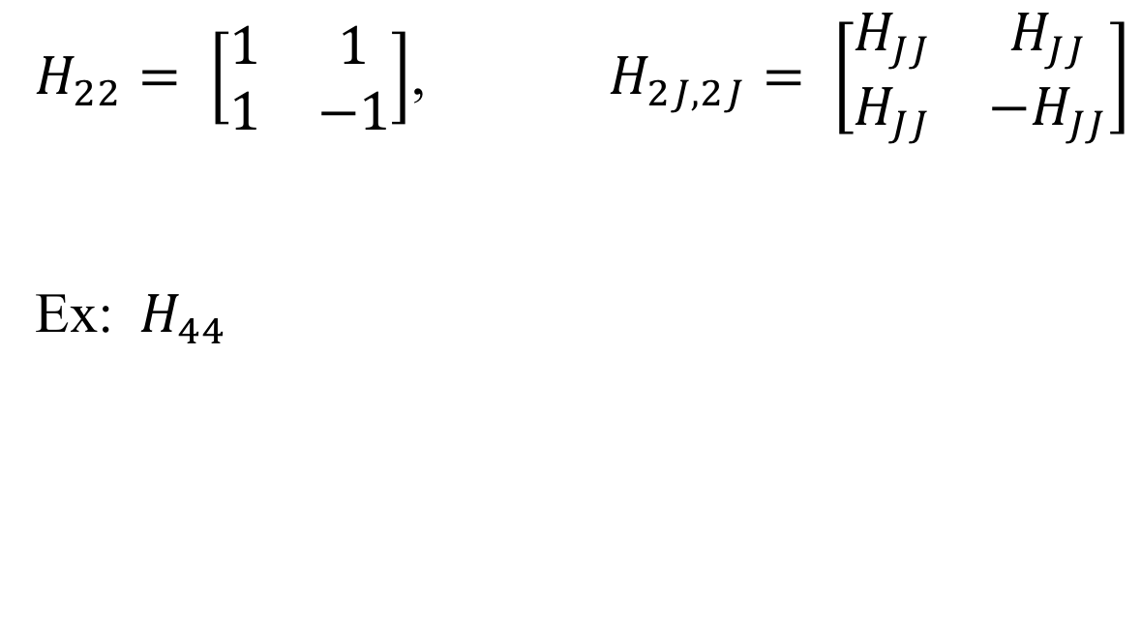
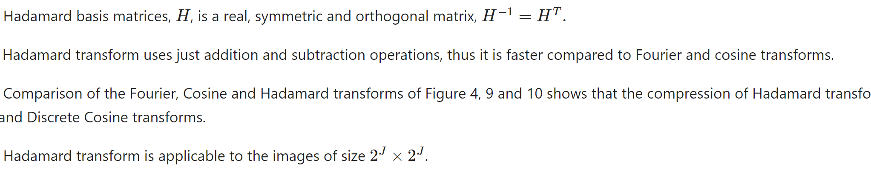

Slide 35
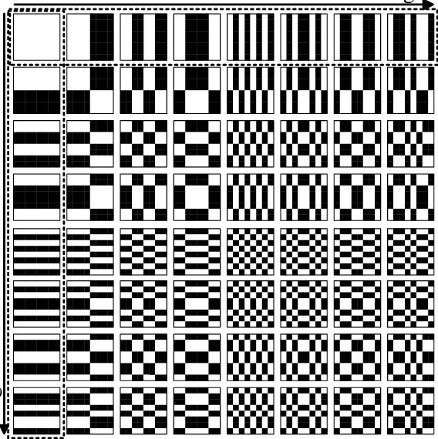
Hadamard Basis Matrices for 8x8 images

Slide 36
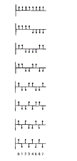
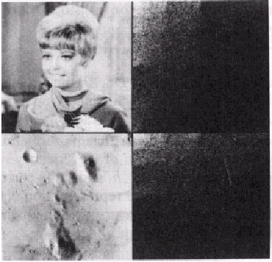
Hadamard Transform
Basis vectors for one-d
Walsh-Hadamard transform

Slide 37
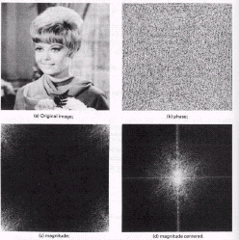
DFT , DCT , Hadamard Transforms
Cosine
Hadamard

Slide 38
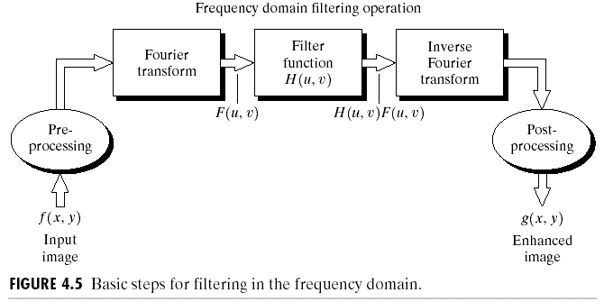
Filtering in Frequency Domain

Slide 39

Recall Convolution Property
$$f(x,y)∗h(x,y)⇔F(u,v).H(u,v)$$
Note: In frequency domain, we use array multiplication.

Slide 40
Frequency Domain Filters
 | Ideal | Gaussian | Butterworth
Lowpass filters
Highpass filters
Band filters.

Slide 41
1. Low pass Filters
Ideal Filters
Gaussian Filters
Butterworth Filters

Slide 42
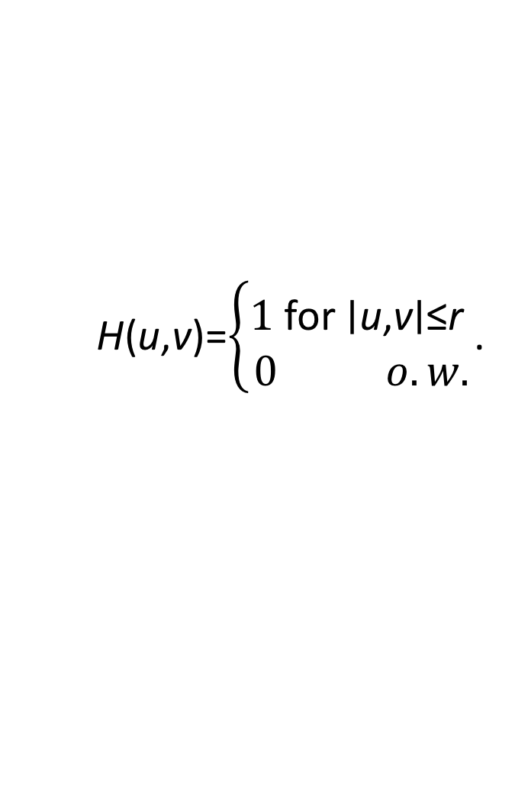
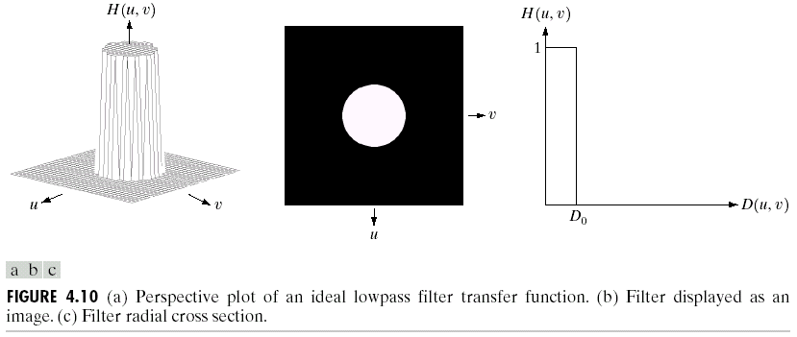
1.1. Ideal Low pass filter

Slide 43
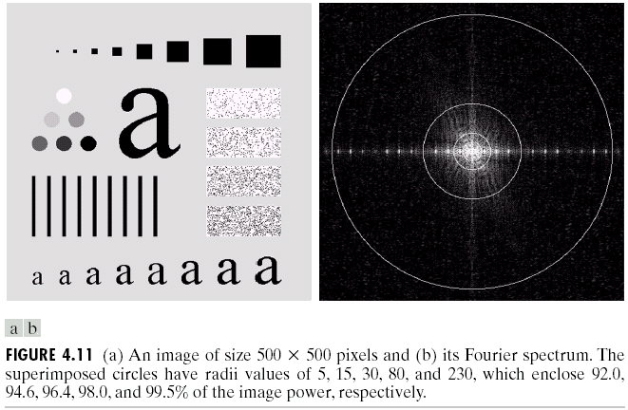
Ideal Low Pass Filter

Slide 44
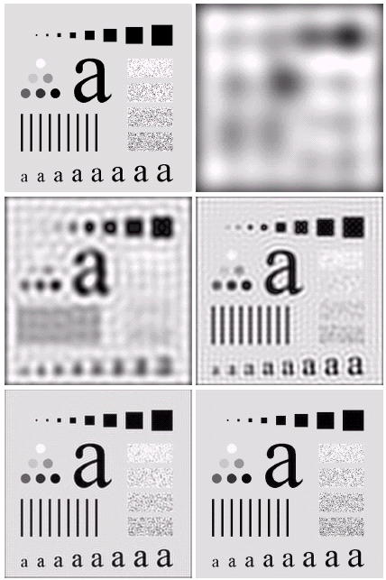

Ideal Low Pass Filter Outputs

Slide 45




1.2. Gaussian Low Pass Filters
Note: Weight values decrease with distance from mask center!

Slide 46

Ideal vs. Gaussian LPF

Slide 47

Gaussian Low Pass Filtering for Document Image Analysis

Slide 48


1.3. Butterworth Low Pass Filter

Slide 49

Butterwoth Low Pass Filters in Spatial Domain

Slide 50

2nd Order Butterworth Filtering with Different Cutoff Frequencies

Slide 51
Comparison of Ideal and Butterworth Low Pass Filtering

Slide 52
2. High Pass Filters: Edge detectors in Frequency Domain
Ideal High Pass Filters
Gaussian High Pass Filters
Butterworth High Pass Filters

Slide 53

High pass filters pass only the high frequency components of the image, outside a circle centered at the origin of F(u,v)
High pass and low pass filters can be considered complement of each other. They are related by the following equation;
$$H_{HP}​(u,v)=1−H_{LP}​(u,v)$$

Slide 54


2.1. Ideal High Pass Filters are Complement of Ideal Low Pass Filters
$$Hhp​(u,v)=1−Hlp​(u,v)$$
Ideal High Pass Filter
Ideal Low Pass Filter

Slide 55

2. 2,3. Gaussian and Butterworth High Pass Filters are Complement of Low Pass Filters

Slide 56
Ideal, Butterworth and Gaussian High Pass Filters

Slide 57

Space Domain Representation of Ideal, Butterworth and Gaussian High Pass Filters

Slide 58

2. 1 Ideal High Pass Filter Outputs

Slide 59

2. 2. Gaussian High Pass Filter Outputs

Slide 60
GHPF vs Ideal HP Outputs

Slide 61

2.3 Butterworth High Pass Filter

Slide 62


Slide 63



3. Band Filter
Band Pass Filters
Band Reject Filters
$$HBP​(u,v)=1−HBR​(u,v)$$

Slide 64

Band Reject filters

Slide 65

Band Pass Filters

Slide 66

Band Reject Filters: Remove the blackened areas in Fourier Domain

Slide 67



Band Reject Filters
Noisy image; periodic noise as vertical lines
The 2-D spectrum of the image and the filters applied:
In the regions corresponding to the vertical lines frequencies
Image restoration through filtering

Slide 68

Quiz#6:
Consider the DFT and DCT of NxN image, f, as matrix similarity transform:
$F=$Φ_{NN} f Φ_{NN} and $Fc =$ C_{NN} f C_{NN}
Derive the Fourier and Cosine base ,matrices, Φ_{NN} and C_{NN} for N=4.

Slide 69

Frequency Domain and Space Domain Filters

Slide 70


Slide 71


Slide 72

Inner Product, Orthogonality, Basis
Inner Product: Given $x, y∈V,$
$$<x,y> :V×V→R$$
is a linear and conjugate symmetric map, satisfying
$<x,y>$ = $<y,x>$
Orthogonality : Two vectors are orthogonal iff
$<x,y>$ = $\left\{\begin{aligned}0 for x≠y \\ 1 x=y.\end{aligned}\right.$
Basis: A set of linearly independent vectors, which spans the vector space.

Slide 73


Hilbert Spaces: Extension to vector spaces, where vectors are functions, matrices, polynomials etc.
For example: Inner product for function spaces is defined by
David Hilbert

Slide 74




Representation of periodic functions in terms of waves of different oscillations
=
$$f(x) =$$

Slide 75

Euler Formula
$$e^{jφ}=cosφ+jsinφ$$

Slide 76


Fourier Series: Any periodic function can be represented as linear combination of sines and cosines

Slide 77


Fourier Domain is a specific form of Hilbert Spaces
Functions, $sin mx$and $cos mx$ (m is integer) form an orthogonal basis
or
Complex exponentials form an orthogonal basis
Fourier Series: Representation of a periodic function in a space spanned by complex exponentials:

Slide 78

Orthogonality of complex exponentials
$$<{\text{e}}^{2πj{ux}_{1}}{ . \text{e}}^{−2πj{ux}_{2}}> ≜ ∫{\text{e}}^{2πj{ux}_{1}}{ . \text{e}}^{−2πj{ux}_{2}}du$$
$$=0 , for{ x}_{1} { ≠x}_{2}$$

Slide 79


Slide 80
Fourier transforms

Slide 81


Slide 82

3.1 Bandpass filters

